Slide 1
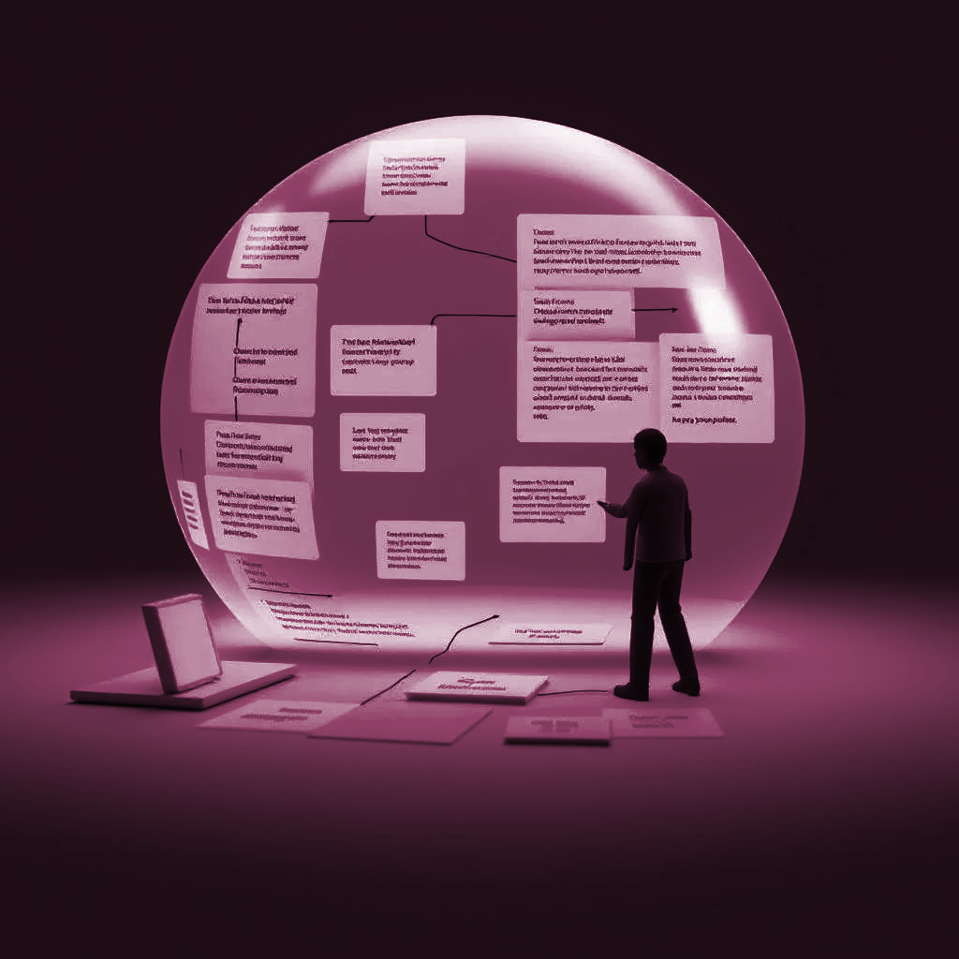
Teaching UML using a RAG-based LLM
Pasquale Ardimento - Mario Luca Bernardi - Marta Cimitile 2024
Mariana Dakwar - Nadine Zeibaq

Slide 2

Motivation and Problem
Learning UML is difficult: Students often repeat mistakes and struggle to grasp modeling concepts, espically novice studets.
Current teaching tools lack support: They don’t guide students during the modeling process.
LLMs have potential: But existing uses don’t effectively help beginners or provide targeted feedback.
The Goal: To help students better understand UML and succeed in creating accurate, well-structured diagrams.

Slide 3

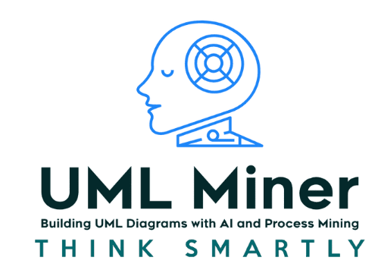


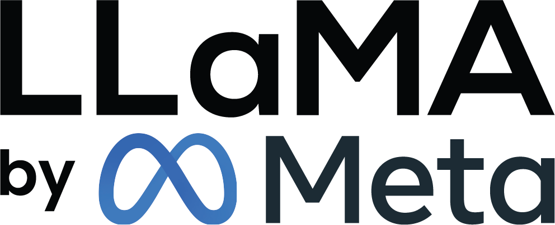
SOLUTION: Leverage RAG-based LLMs to deliver immediate, meaningful feedback on UML diagrams.
Innovative approach: Combines Retrieval Augmented Generation (RAG) with LLaMA Language Models
Non-intrusive monitoring: Captures students' modeling activities in Visual Paradigm without interruption
Domain-specific feedback: Leverages UML knowledge to provide contextual suggestions
Immediate assistance: Helps students identify and correct modeling errors in real-time
Reduces teacher workload: Automates feedback for common mistakes
RAG
FEEDBACK

Slide 4
Key terms
RAG (Retrieval-Augmented Generation) An approach where the model retrieves relevant documents before generating a response — improving feedback accuracy.
LLaMA A family of large language models used in this study (7B to 70B parameters) that generate feedback based on context.
Diagram Info Plugin A Visual Paradigm plugin that extracts UML diagram data as structured text — including elements, attributes, and relationships.
Vector Space / Vector Store A database of vector embeddings representing UML diagram information — used for retrieval based on similarity.
Ecore A modeling framework from the Eclipse ecosystem, used to define the structure and metadata of models — similar to UML but more abstract.

Slide 5
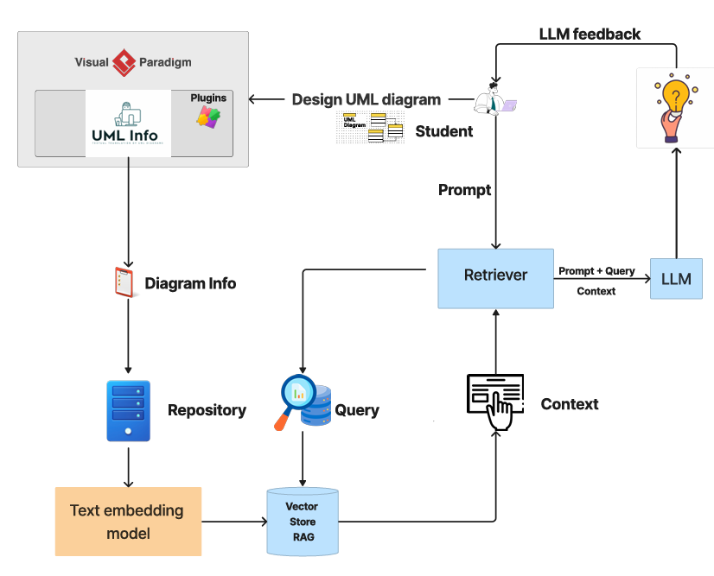
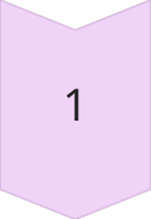
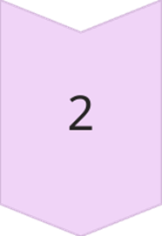
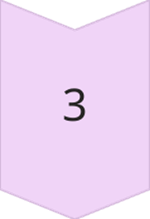
How It works:
Capture & Represent the UML Diagram
Student designs UML diagrams in Visual Paradigm.
A plugin (UML Info) automatically extracts diagram data and stores it as structured text in a repository.
Retrieve Relevant Context Using RAG
A retrieval engine uses the student’s question + stored UML info to find relevant context via a Vector Store
Generate AI-Powered Feedback
The LLM combines the student’s prompt with retrieved context,It generates actionable feedback

Slide 6
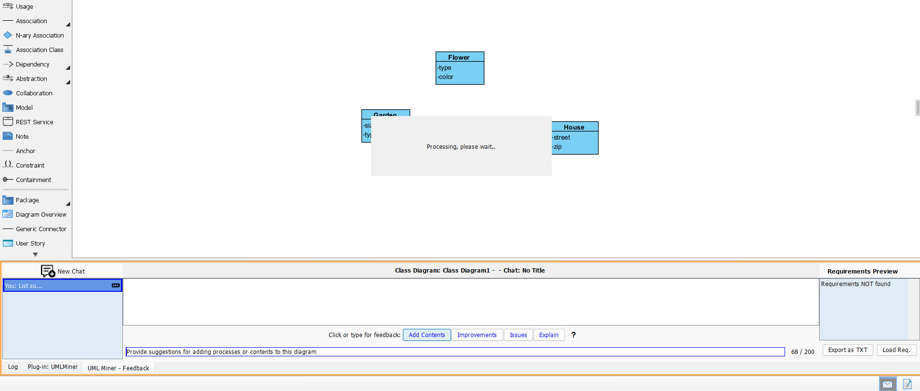
SUGGESTIONS FOR PROMPT
PROMPT

Slide 7
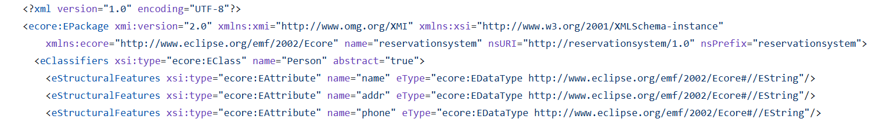
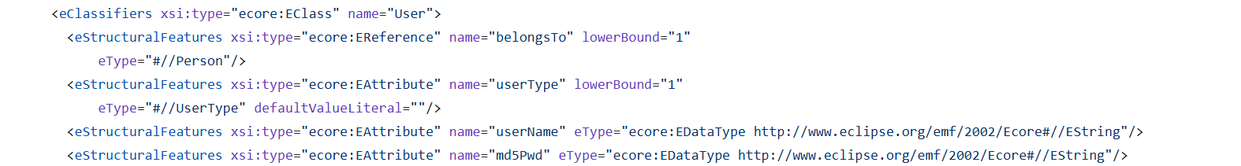
ModelSet - DataSet
ModelSet is a public dataset that includes 5,120 labeled UML diagrams and 5,466 Ecore models. In the research, it was used to test how well the system could detect UML elements like classes, associations, and generalizations. The system’s feedback was compared to expert answers, and its accuracy was measured using Precision, Recall, and F1 score.

Slide 8

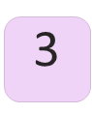
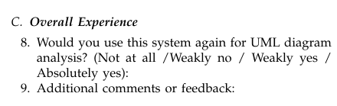
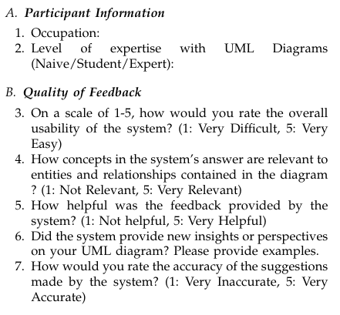
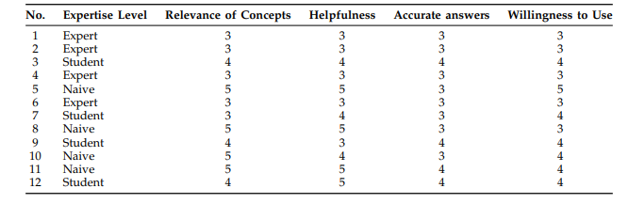
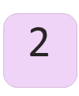
DESCRIPTION OF THE EXPERIMENT
Objective
Qualitative Validation
Evaluate the effectiveness of the RAG-LLM system compared to a baseline (Plain version) in recognizing correct entities and relationships in UML diagrams.
Questionnaires administered to 12 participants to assess satisfaction, usefulness, and perceived accuracy.
Quantitative Validation
Measure precision, recall, and accuracy by comparing system responses with expert annotations.

Slide 9
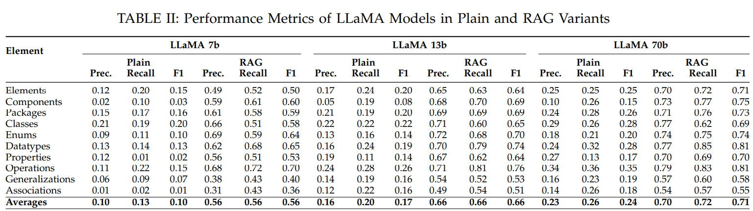
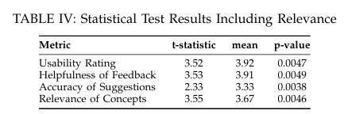
RESULTS
LLaMA with RAG outperformed the Plain LLaMA in providing accurate UML feedback.
The RAG version gave more relevant, detailed, and context-aware suggestions.
Students benefited from real-time guidance on their diagrams, leading to fewer repeated mistakes.
Participants rated the feedback as helpful, understandable, and aligned with UML concepts.

Slide 10
CONCLUSIONS AND LIMITATIONS
Limitations / Threats to Validity
Use of Open LLMs:
The study relies on open models like LLaMA instead of closed models due to flexibility and cost.
Rapid Model Evolution:
LLMs evolve quickly, so the results may become outdated as new models are released.
Reproducibility Issues:
Because LLM responses can vary even with the same prompt, it's difficult to replicate the experiment exactly.
Conclusions
This research demonstrates that RAG-based LLMs can play a meaningful role in supporting UML learning by providing timely, relevant feedback that helps students understand and correct their mistakes.
From our own experience as Information Systems students, we know how valuable that kind of support can be. Peers often acted like “human RAGs,” drawing on prior knowledge to catch issues — this system replicates that role, but at scale and with consistency.
Future Work
-Expand the system’s capabilities beyond UML class diagrams to support additional UML diagram types and modeling languages.

Slide 11

THANK YOU QUESTIONS?

Slide 12


ACTIVITY

Slide 13
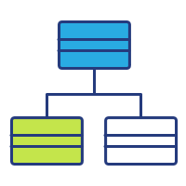



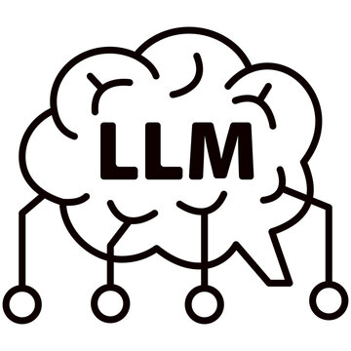


CLASS WILL BE DIVIDED INTO 2 ROLES : -10 STUDENTS TO SUBMIT A CLASS DIAGRAM TASK -10 STUDENTS TO PLAY THE ROLE OF RAG BASED LLM
10 Students to submit a class diagram task
10 Students to evaluate a class diagram as an LLM
TASK
REPOSITORY

